Slide 1
Chapter 12 Analysis of Variance
Notes:
Sometimes, like in t-tests, we want to compare group means (interval level DV)… but where we have more than two groups in the IV (categorical/nominal or ordinal).
The bulk of our sociological questions deal with more than two groups:
we may want to see the influence of ethnic identity (white, black, asian, latino) on church attendance. Has to go beyond two-groups compared
we may want to look at educational attainment for blacks versus whites (including men versus women)… which is now 4 groups: BW,BM,WW,WM
This is why we move beyond the two-sample/independent samples t-test to the more complicated analysis of variance (ANOVA).
ANOVA follows the same steps for hypothesis testing that we used for t-tests (Z-tests)

Slide 2
ANOVA
Inferential technique to test for significant relationship between two variables
where independent variable is nominal/ordinal with more than two samples
Looks for differences in means
between all samples and within each individual sample
Notes:
Recall, t-test looks at differences in means between two samples (so diffs between two means Ybar1 and Ybar2) and the null hypothesis is that there is no mean difference between the two samples (mu1 = mu2)
Logic of anova is same, but examines variation/difference/variance in numerous means (Y1, Y2, Y3, Y4 are all compared), and the null hypothesis isthat all means are equal (mu1 = mu2 = mu3 = mu4).

Slide 3
ANOVA
H₀: All sample means are equal
μ₁ = μ₂ = μ₃ = μ₄ …
H₁: Sample means are not equal
μ₁ ≠ μ₂ ≠ μ₃ ≠ μ₄ …
Rejecting null means:
there is significant variation in sample means
At least one sample mean is significantly different than the others
Notes:
Logic of anova is same, but examines variation/difference/variance in numerous means (Y1, Y2, Y3, Y4 are all compared), and the null hypothesis isthat all means are equal (mu1 = mu2 = mu3 = mu4).

Slide 4
ANOVA
To determine if differences are significant, ANOVA examines variances between the samples, as well as variances within each sample.
If overall (summed) variance between samples is larger than the overall (summed) variance within samples, we know that the dependent variable varies significantly across the different samples in our independent variable
The samples have significantly different means

Slide 5
Example: ANOVA
See pages 390-391

Slide 6
ANOVA
One-way ANOVA
ANOVA with one dependent and one independent variable

Slide 7
Hypothesis Testing with ANOVA
Assumptions
Independent random samples are used
The dependent variable is measured at the interval-ratio level
The independent variable has more than two groups/categories
The population is normally distributed
Notes:
Lax assumption: The population variances are equal
Some researchers apply ANOVA to ordinal level measurements

Slide 8
Hypothesis Testing with ANOVA
Stating the Research and Null Hypotheses

Slide 9

Hypothesis Testing with ANOVA
Between-Group Sum of Squares
The mean difference between all groups
n_{k} = the number of cases in a sample
= the mean of a sample
= the overall mean
Notes:
SSB

Slide 10

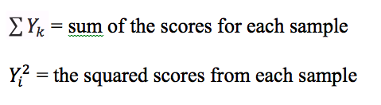
Hypothesis Testing with ANOVA
Within-Group Sum of Squares
The mean difference in scores within a single sample, then sums them up
Amount of unexplained variance
Notes:
SSW is the sum of squares within, calculated between each individual score and the sample mean.

Slide 11
Hypothesis Testing with ANOVA
Total Sum of Squares
Sum of the within and between sum of squares
Total variation in scores
SST = SSB + SSW

Slide 12
Hypothesis Testing with ANOVA
ANOVA statistic (F) is based on a ratio of mean square between divided by mean square within
We can calculate mean squares using our sum of squares calculation, divided by degrees of freedom (within and between)
So we need degrees of freedom calculation

Slide 13
Hypothesis Testing with ANOVA
The ratio of between-group variance to within-group variance

Slide 14
Hypothesis Testing with ANOVA
Calculating degrees of freedom (df)
Between
df_{b} = k -1
Where k is the number of samples
Within
df_{w} = N – k
Where N is the total number of cases and k is the number of samples

Slide 15
The F Statistic (ANOVA Value)
The ratio of between-group variance to within-group variance

Slide 16
Definitions
F ratio (F statistic) | Used in an analysis of variance Represents the ratio of between-group variance to within-group variance
F obtained | Computed by the ratio for between-group to within-group variance
F critical | The F score associated with a particular alpha level and degrees of freedom Marks the beginning of the region of rejection for our null hypothesis

Slide 17
Example: Education Levels by Sex and Race
N = 21
k = 4
(number of groups)
SSB = 31.83
(see page 395)
SSW = 45.33
(see page 396)
df_{b} = k - 1 = 4 – 1 = 3
df_{w} = N - k = 21 – 4 = 17

Slide 18
Example: Education Levels by Sex and Race
MS_{b} = SSB / df_{b} = 31.83 / 3 = 10.61
MS_{w} = SSW / df_{w} = 45.33 / 17 = 2.67
F = MS_{b} / MS_{w} = 10.67 / 2.67 = 3.97

Slide 19
Example: Education Levels by Sex and Race
Using our two df values and our obtained F, we can determine the significance whether our F is significant
df_{b} = 3
df_{w} = 17
F = 3.97

Slide 20
Example: Education Levels by Sex and Race
Next, we choose a table to use in Appendix E (p 487) based on our alpha level (α = .05 or α = .01)
Table will help us determine whether or not our obtained F is significant at either the .05 or .01 level
Begin with the α = .05 table
Select the column associated with our df_{b} value and the row associated with our df_{w} value, we find the value that intersects both. This is our critical F.
If our obtained F is larger than the critical F, we know our obtained F is significant (at least at the p=.05 level)

Slide 21
Example: Education Levels by Sex and Race
In our example, we have the following:
df_{b} = 3
df_{w} = 17
F = 3.97
In our Appendix E (α = .05 ), we follow the df = 3 column and df = 17 row, we get a critical F = 3.20
Because our obtained F is larger than the critical F, we know that our F is significant, meaning that (at least) one of our group means is significantly different than others.
Next, we can use the α = .05 table to see if our obtained F is ALSO greater than the critical F (at those degrees of freedom) for that table. But we do know that…
p < .05

Slide 22
Example: Education Levels by Sex and Race
Report
The test used
If you reject or fail to reject the null hypothesis
The variables used in the analysis
The degrees of freedom, calculated value of the test, and p-value
F(dfb,dfw) = F value, p-value
“Using a one-way ANOVA, I reject the null hypothesis that there is no mean difference in years of education across groups (by gender and race), F(3,17) = 3.97, p < .05”

Slide 23
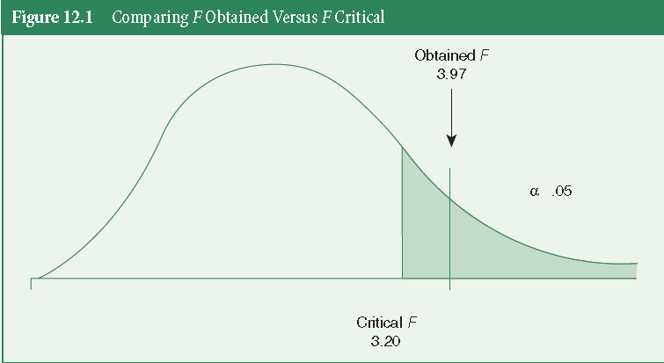

Slide 24
The 5 Steps: A Summary
An analysis of variance test examining the difference between four demographic groups and their average years of education

Slide 25
The 5 Steps: A Summary
Making Assumptions
Independent random samples are used
The dependent variable is an interval-ratio level
The population is normally distributed

Slide 26
The 5 Steps: A Summary
Stating the Research and Null Hypothesis and Selecting Alpha
H₁: At least one mean is different from the others
H₀: µ₁ = µ₂ = µ₃ = µ₄
alpha = .05

Slide 27
The 5 Steps: A Summary
Selecting the Sampling Distribution and Specifying the Test Statistic
The F distribution and F statistic are used to test the significance of the difference between the four sample means

Slide 28
The 5 Steps: A Summary
Computing the Test Statistic
We need to calculate the between-group and within-group variation
We estimate SSB = 10.61 (dfb = 3) and SSW = 2.67 (dfw = 17)

Slide 29
The 5 Steps: A Summary
Making a Decision and Interpreting the Results
We reject the null hypothesis and conclude that the groups are different in their educational attainment
Our F obtained of 3.97 is greater than the F critical of 3.20. The probability of 3.97 is <.05

Slide 30
Key Terms
Mean square between
Mean square within
One-way ANOVA
Total sum of squares (SST)
Within-group sum of
squares (SSW)
Analysis of variance
Between-group sum of
Squares (SSB)
F critical
F obtained
F ratio or F statistic

